Slide 1
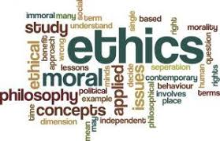
Introduction to Ethics
Professional Practice 3
N. Wessels

Slide 2
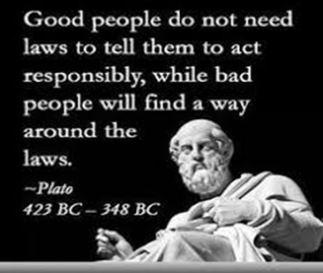
Introduction
According to the Centre of Ethics, ethics aims to answer one big question…
How should I live?
http://www.ethics.org.au/about/what-is-ethics
Ethical beliefs shape the way we live – what we do, what we make and the world we create through our choices.
The term is derived from the Greek word ethos which can mean custom, habit, character or disposition.
Traits which constitute good ethics and character are:
Honesty > Integrity > Respect > Professionalism

Slide 3
Definition
What is ethics?
ETHICS IS A SET OF BELIEFS ABOUT RIGHT AND WRONG BEHAVIOUR
Ethics is the branch of philosophy that examines right and wrong moral behavior, moral concepts (such as justice, virtue, duty) and moral language.
Virtues
– Habits that incline people to do what is acceptable
• Vices
– Habits of unacceptable behavior
• Virtues and vices define a personal value system
– Scheme of moral values
At its simplest, ethics is a system of moral principles. They affect how people make decisions and lead their lives.
Ethics is concerned with what is good for individuals and society and is also described as moral philosophy.

Slide 4
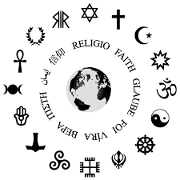
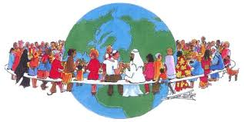
Definition cont’d
Ethics covers the following dilemmas:
how to live a good life
our rights and responsibilities
the language of right and wrong
moral decisions - what is good and bad?
Our concepts of ethics have been derived from religions, philosophies and cultures. They infuse debates on topics like abortion, human rights and professional conduct.

Slide 5
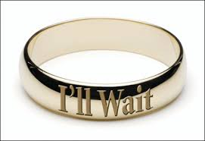
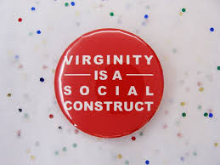
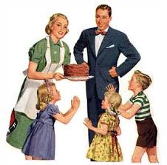
Definition cont’d
Ethics are the social conventions about right and wrong, also known as morality. However, morality may vary based on different factors that may affect our worldview like:
Age
Cultural group
Ethnic background
Religion
Life experiences
Education
Gender

Slide 6
Why be ethical?
Lots of people like to play devil's advocate and ask why they should be ethical. After all, sometimes doing what's ethical comes at a personal cost.
If ethics means we can’t exploit other people, tell lies, or steal when these things are in our best interests, why bother?
Ethical questions are an inescapable part of being human. We think and act according to ethical judgments all the time, whether we want to or not.
Often the things that drive our actions are unknown to us – underpinning habits that lead us to act for good or ill without serious thought. Ethical reflection helps us make responsible judgments that reflect what we care about most.

Slide 7
Why be ethical? The importance of integrity
Integrity is a cornerstone of ethical behavior.
People with integrity:
Act in accordance with a personal code of principles.
Extend to all the same respect and consideration.
Apply the same moral standards in all situations.
One objective of critical analysis and critical thinking = making ethical choices. Ethical decisions are not just matters of etiquette or of avoiding wrongdoing. They are matters of choosing actions that are RIGHT. The ability to reflect and examine what drives our actions is crucial in terms of developing critical thinking and ethical behaviour.
Lack of integrity emerges if you apply moral standards differently according to a situation or people involved.

Slide 8
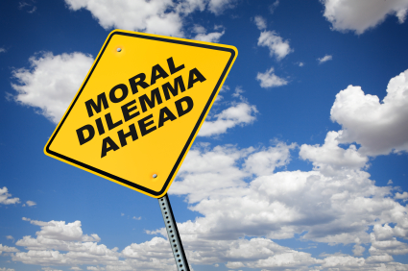
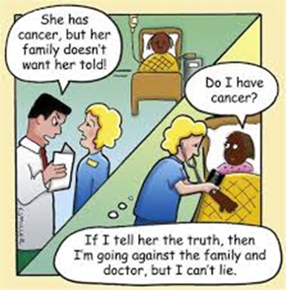
Ethical dilemmas
Lots of things in our lives have moral value - sometimes they come into conflict. Moral or ethical dilemmas are inevitable!
E.g. Should you tell a lie to protect a family member who has done something wrong? Lots of people would say lying is always wrong. But those same people also probably think we have special duties to take care of our families. Our answer in a case like this depends on how much we value certain ideals - truth or family. What if we value both equally? This is where ethics gets tough. Unfortunately, even when faced with a moral dilemma, we still have to make a decision. In these cases we need to accept the limits to certainty when trying to decide what we ought to do. Sometimes our range of choice is reduced to picking the least bad alternative. Sometimes we may feel genuinely 'stuck' by a problem. In those cases we may just have to trust our experience and our conscience. | Many ethical dilemmas are not as simple as right versus wrong.

Slide 9
Ethical dilemmas - ethical tools
Luckily most decisions aren't moral dilemmas and we can work out what to do with the help of a few ethical tools. There are questions it's worth asking before we make a decision:
1. Would I be happy for this decision to be headlining the news tomorrow?
This question is what's known as the Sunlight Test. Imagine how it might feel if your decision – and the reasons you made it – were public knowledge. What if the people you most admire knew what you'd done and why? Note – it’s the ‘don’t be ashamed’ test, not the ‘don’t get caught’ test.
2. Is there a universal rule that applies here?
Is there a rule that any reasonable person should apply to this situation regardless of the consequences? Some rules are unbreakable, even when the stakes are high. For instance, we should never act in ways that undermine the equality and dignity of all people – ourselves included. The rules are often associated with duties – some of which we create ourselves, like when we make a promise.

Slide 10
Ethical dilemmas - ethical tools
3. Will the proposed course of action bring about a good result?
We often think about ethics in terms of consequences. 'The greatest good for the greatest number' is a maxim many people recognise and accept. Consequences are an important part of ethical decisions, but are they everything?
We should be aware of what we're sacrificing when trying to bring about good consequences. Are we violating an important principle? Are we compromising our own values? If so, have we considered these facts when balancing harms and benefits?
4. What would happen if everybody did this?
Would you be happy if your reason for action was used by everyone in the same circumstance? If not, then what makes you so special? Most ethical frameworks suggest the right decision for one person should be right for everybody in the same position. This test helps guard against 'special pleading' – when we make an exception for ourselves or different groups.
5. What will this proposed action do to my character or the character of my organisation?
Many people believe that our decisions shape our character and vice versa. That is, we can't lie and cheat without becoming a fraudulent liar. Subsequently, if we're a liar we'll tend to lie more often.
Think about whether your action is establishing a habit either for you or your organisation. Is it a good habit (virtue) or a bad one (vice)? If I cut corners on a work job today am I developing a habit of laziness that may affect my future work?

Slide 11
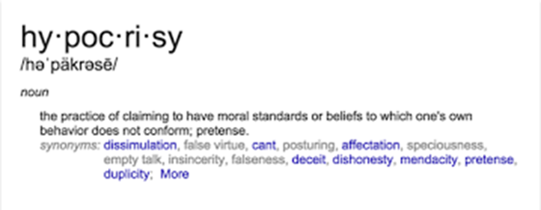
Ethical dilemmas – ethical tools
6. Is the proposed course of action consistent with my values and principles?
Plenty of people and organisations are happy to tell you what they stand for – but do they walk the talk? Are my actions reflecting my ethical beliefs? Most ethical systems have no time for hypocrisy.
Answering these questions doesn't guarantee everyone will accept our decision. Moral disagreement is extremely common. But even the answer to our question doesn't achieve universal approval, the way in which we reach those answers matters. Ethics allows us to explore these questions in a way that is sincere, rational, competent and honest.

Slide 12
There are times when those questions become challenges we just can't resolve alone
We ask ethical questions whenever we think about how we should act. Being ethical is a part of what defines us as human beings. We are rational, thinking, choosing creatures.
Complex ethical problems can be individual and private or widespread and systemic, involving groups, organisations or whole communities. The distress these challenges cause is real and pervasive, leaving people stuck and struggling, anxious or broken.
Ethics provides a framework for answering these questions well. It allows us to be:
consistent in our judgements,
provide reasons for our beliefs and to,
critically examine opinions,
and most importantly, ethics allows us to act in a manner that accords with a set of core values and principles.

Slide 13
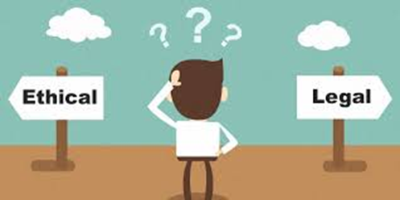
The difference between ethics and law
Since childhood, our parents/caregivers have helped shape our worldview. Part of this involves instilling a fundamental awareness of what is right and wrong based on a moral code.
This awareness is said to be an inherent trait of all humans and grows from our desire to get along well with each other in order to live a harmonious life.
To achieve this goal we understand that we must do to other people what we expect them to do to us in return.
For this, we try very hard to do what we feel and see as the right things to do in certain situations.
This is the foundation of ethics. They are rules of conduct that shows how our society expects us to behave and are the guiding principles behind the creation of laws.

Slide 14
Definition of law
The law is described as a set of rules created by the government to govern the whole of society.
The law is universally accepted, recognised and enforced.
It is created with the purpose of maintaining social order, peace and justice in society and to provide protection to the general public and safeguard their interests.
It is made after considering ethical principles and moral values.

Slide 15
Definition of law
The law is made by the judicial system of the country.
Every person in the country is bound to follow the law.
It clearly defines what a person must and must not do.
Breaching the law may result in punishment or penalty or sometimes both.

Slide 16
Some major differences between ethics and law
The law consists of a set of rules and regulations. As such, legal standards are set forth in the laws of the land.
Ethics is comprised of guidelines and principles that inform people about how to live or how to behave in a particular situation. They are based on human principles of right and wrong, and do necessarily have a legal basis.

Slide 17


Law vs Ethics

Slide 18
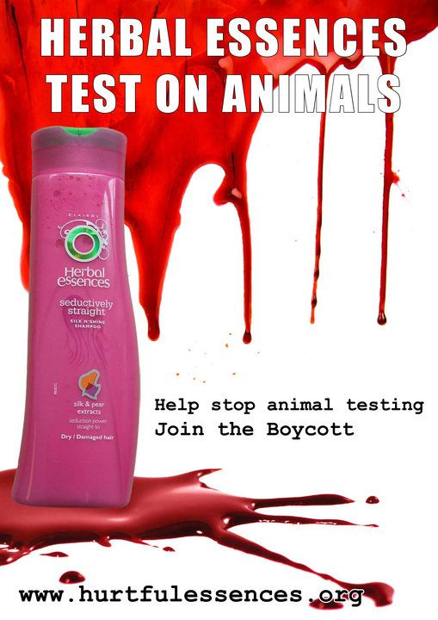
Law vs Ethics
2. Laws are created by the government, which may be local, regional, national or international.
On the other hand, ethics are governed by an individual or by professional norms - For example workplace ethics or environmental ethics.

Slide 19
Law vs Ethics
Laws are written and expressed in various statutes and in the constitution, which has a legal binding on all the people of a region/nation.
On the other hand, not all ethics are expressed in writing – like much of our personal ethics when navigating everyday life.

Slide 20
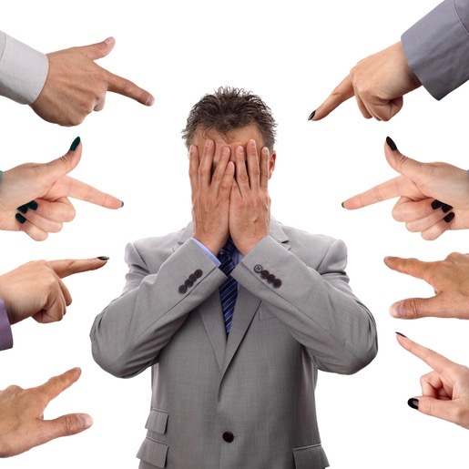
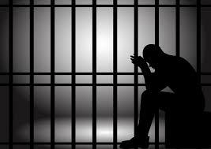
Law vs Ethics
The breach (breaking) of law may result in punishment or penalty, or both, which is not normally the case in the breach of ethics.

Slide 21

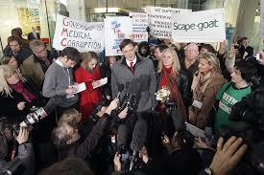
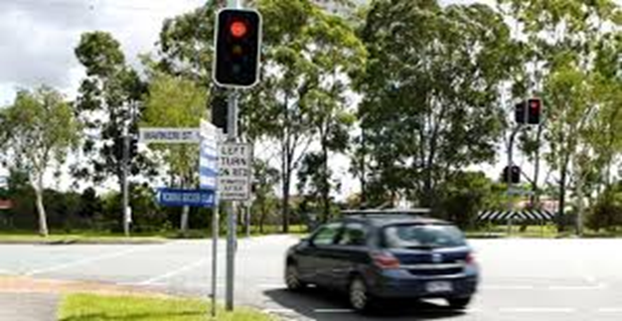
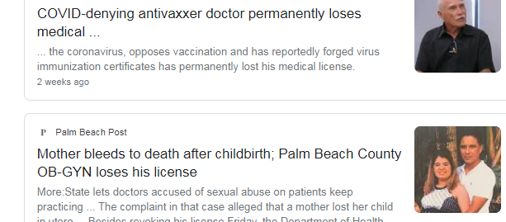


Breach of Law vs Breach of Ethics

Slide 22
Final thoughts…
Ethics comes from a person’s conscience or moral sense and desire to preserve one’s self respect.
It is not as strict as laws.
Laws are codifications of certain ethical values meant to help regulate society, and punishments for breaking them can be harsh and sometimes even break ethical standards. Can you think of an example of this in any society?

